Slide 1
Description of lane properties
Wushuang Bai
2023 09 03

Slide 2
The example files used in this document can be found at https://github.com/ivsg-psu/PathPlanning_MapTools_ParseXODR/blob/main/Data/XODRExport/XODRExport/RR/02ExportedFromScene/RR_Junction_highwayPassing.xodr
For a complete explanation of lane properties, please see https://www.asam.net/index.php?eID=dumpFile&t=f&f=3495&token=56b15ffd9dfe23ad8f759523c806fc1f1a90a0e8#_lane_properties
Open source xodr viewer can be found at: https://odrviewer.io/

Slide 3
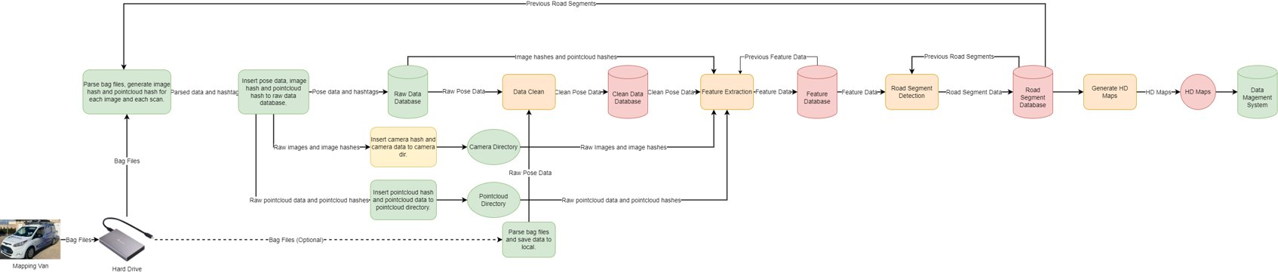
Why we need clear definitions of lane properties? Because this is required to generate HD maps from mapping data in an automatic way!

Slide 4

This document explains the properties to describe a lane based on ASAM OpenDrive 1.6. A simple example of an intersection formed by two straight roads is used.

Slide 5
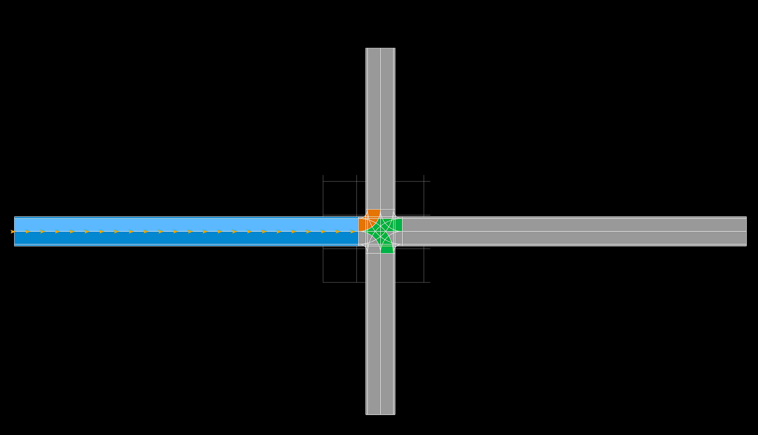
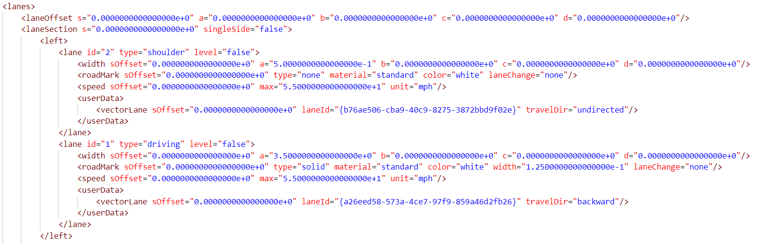
Lane 1 of road 0 is used as an example to explain the lane properties.
Definition in xodr
Visual in xodr viewer

Slide 6
Step 1. Lane offset is described.

Slide 7
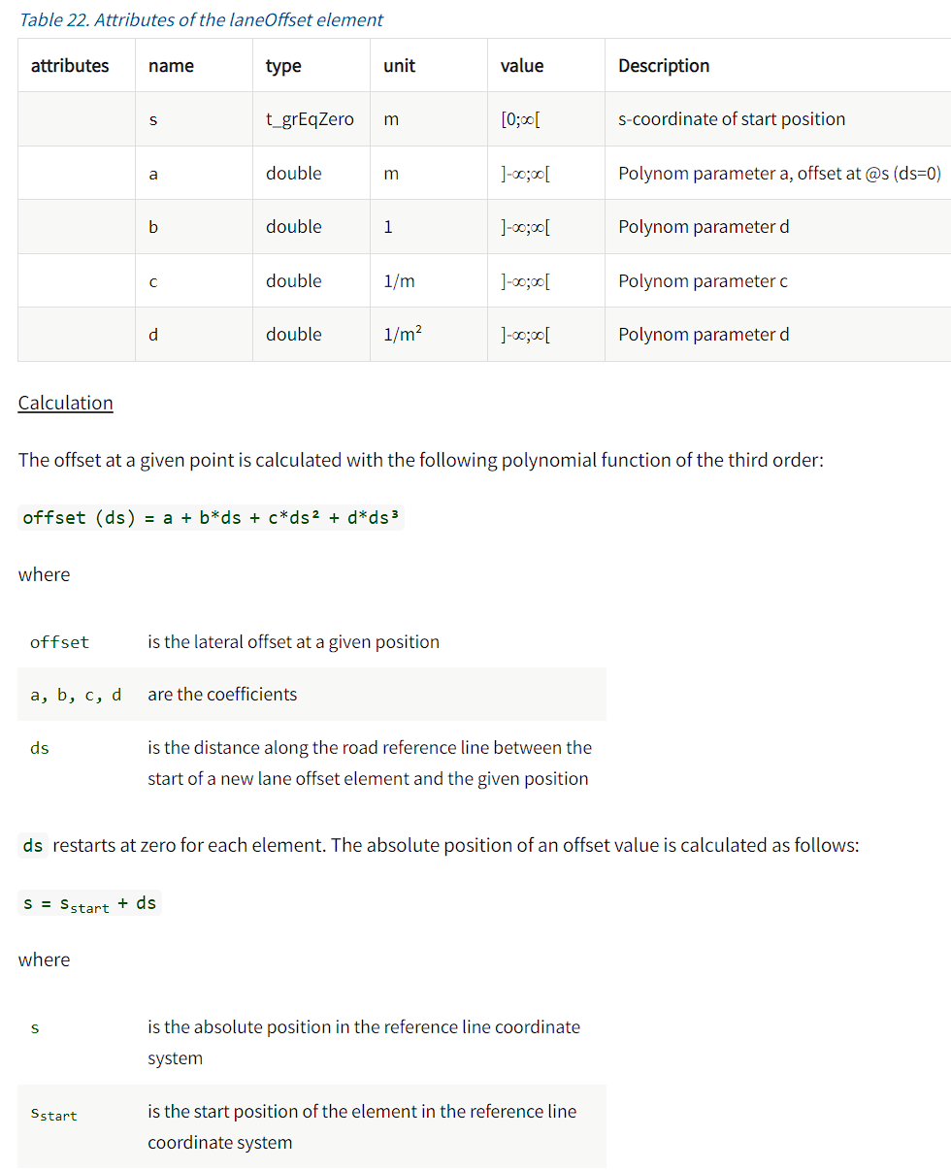
The attributes of lane offset are described below.
The lanes are constructed as polynomials, usually. This is NOT how the mapping process is done, so we use fitting tools to convert actual field datapoints into polynomials.

Slide 8

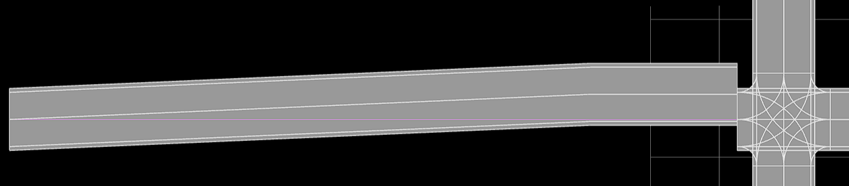
An example of lane offset is below. A lane offset is added at s = 75.
Original lane
Modified lane

Slide 9
Step 2. Lane section is described.

Slide 10
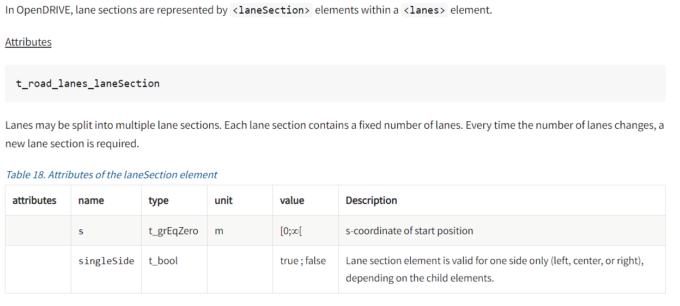
The attributes of lane section are below.
Lanes can be difficult to describe within construction zones, and lane ambiguity is likely to be the largest challenge for AVs

Slide 11
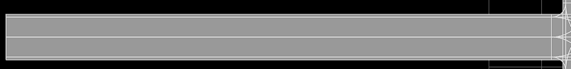
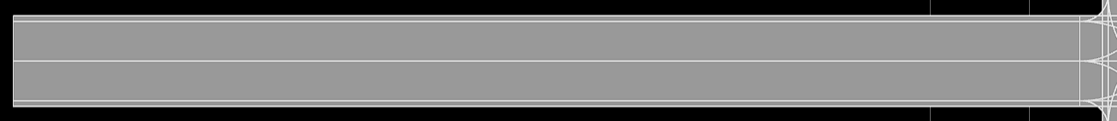
The effect of “singleSide” attribute is not able to visualize. However, it may affect the traffic rule applying to vehicles.

Slide 12
Step 3. Whether this lane is left, center, or right is described.

Slide 13
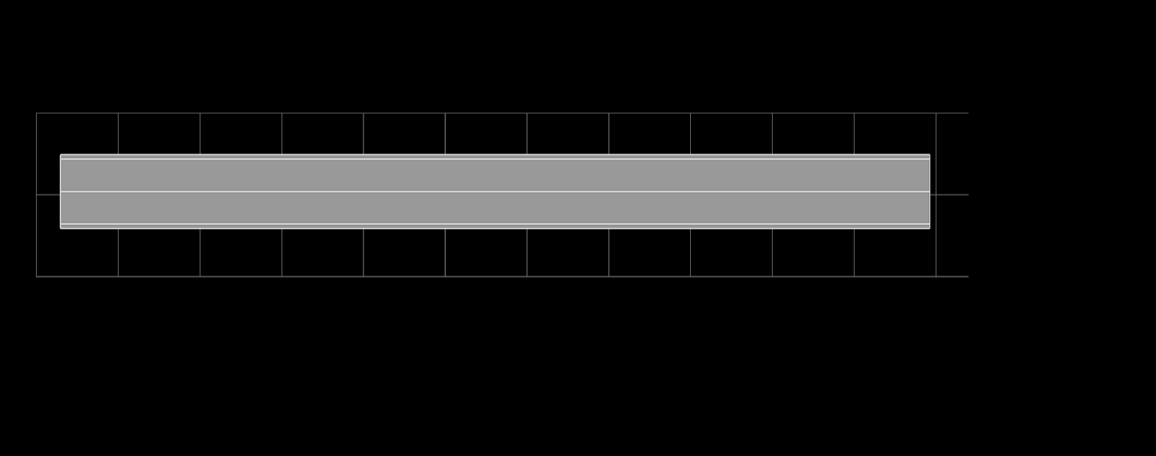
Changing the <left> to <right> breaks the file, since a <right> element already exists, and this causes a conflict.
Bird view of the original road
Bird view when changing <left> to <right> in road 0. The road is broken.

Slide 14
Step 4. Lane ID, type and level are described. Here we use the “driving” lane as example since this is the primary lane type we use.

Slide 15
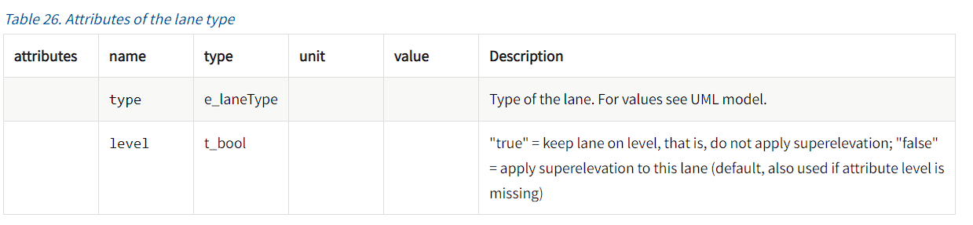
Step 4. Attributes of a lane type are below.

Slide 16
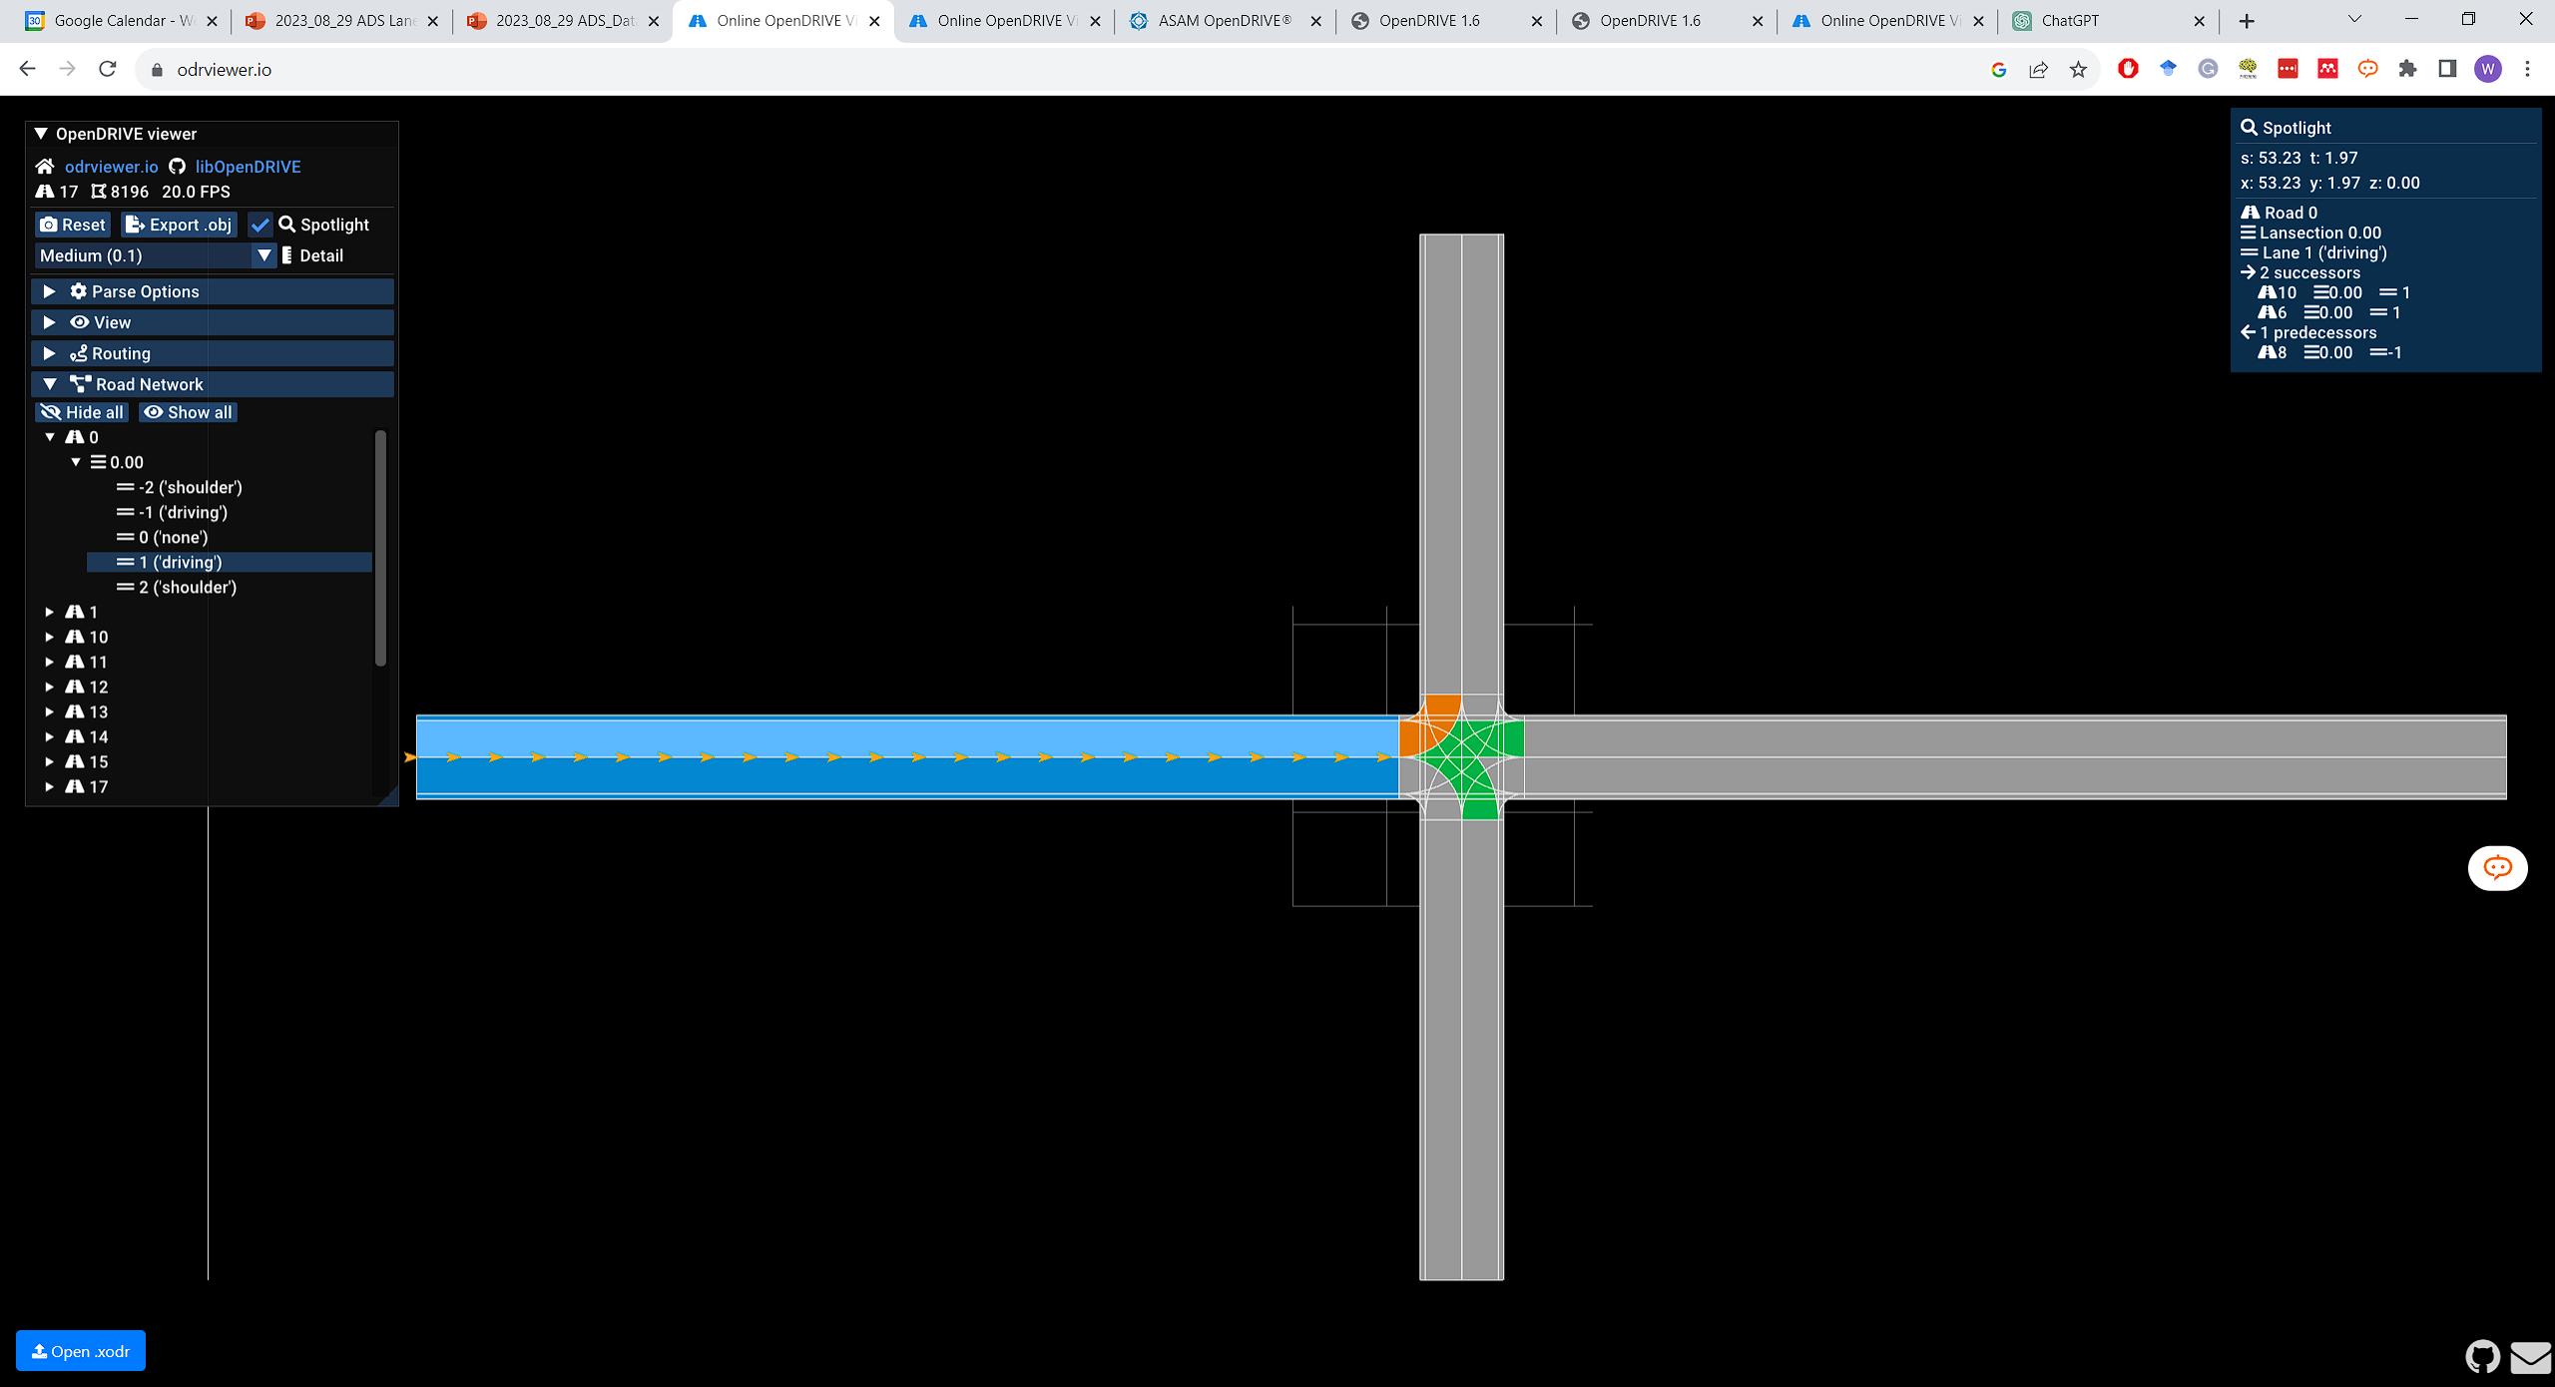
Changing the lane type does not affect the visual. However it may affect the traffic rule applying to vehicles.
Original road

Slide 17
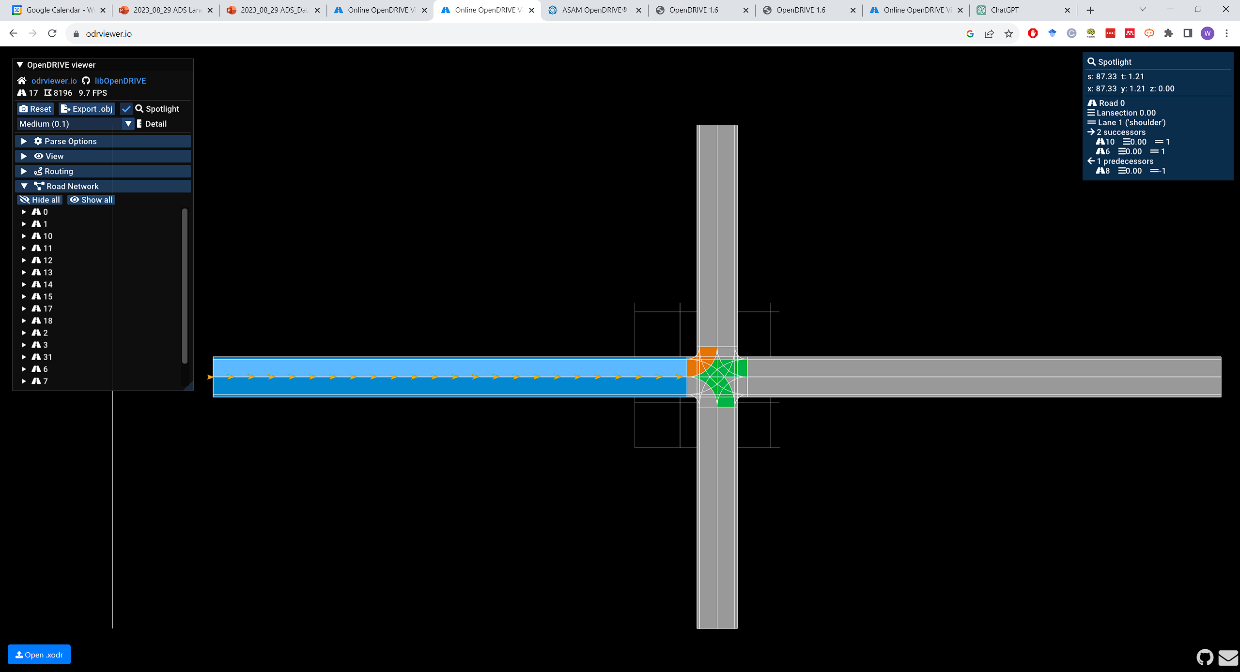
Changing the lane type does not affect the visual. However it may affect the traffic rule applying to vehicles.
Lane 1 type modified

Slide 18
Step 5. Lane width is described.

Slide 19
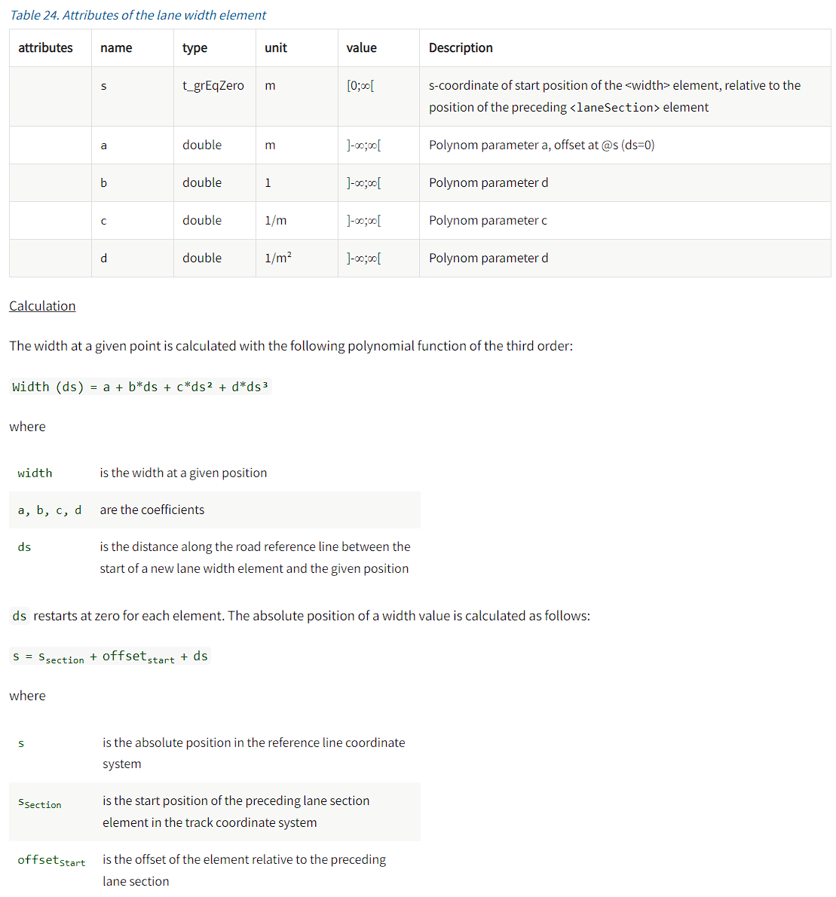
Step 5. Attributes of lane width are below.
Lanes widths are designed in the HD map to change within the WZ area. This change is also represented as a polynomial. This requires a careful definition of a lane’s “centerline”

Slide 20

Changing the attributes of lane width affects how the lane width goes as per the geometry description.
Original lane width
Modified lane width at sOffect = 50 m

Slide 21
Step 6. Road mark is described.

Slide 22
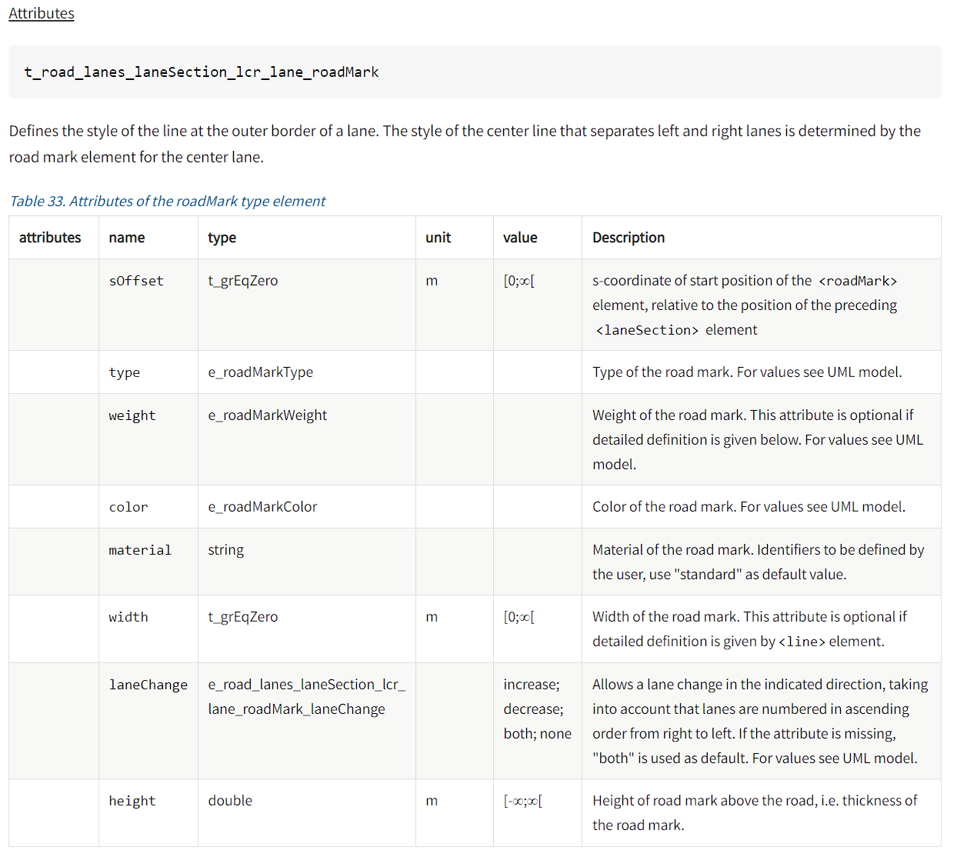
Step 6. Attributes of road mark are below.

Slide 23
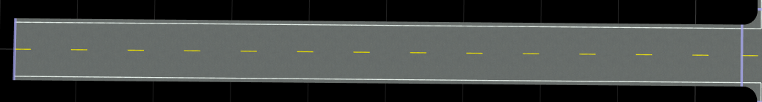
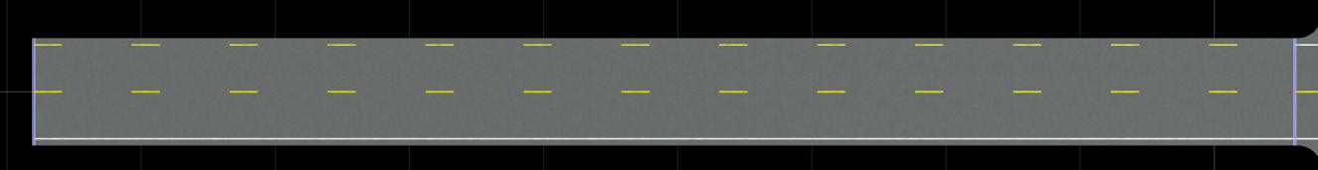
Change of roadMark’s attributes can be visualized. Here shows an example where changing type from solid to broken, and color from white to yellow. Please note visualizing road mark is not supported by the open-source xodr viewer, so the example shown on this slide is tested in RoadRunner.
Original road mark, viewed in RoadRunner.
Modified road mark, viewed in RoadRunner.

Slide 24
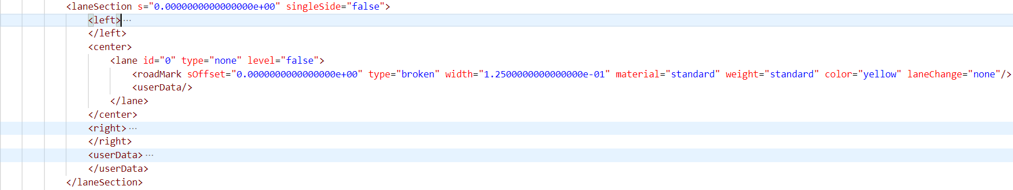
Another example shows here that roadmark can also be changed in the midway. A new <laneSection> needs to be created for this end.
Xodr of the original road. Note <left> and <right> are compressed here for simplification.
Original road. It has a dashed yellow road mark in the center.

Slide 25
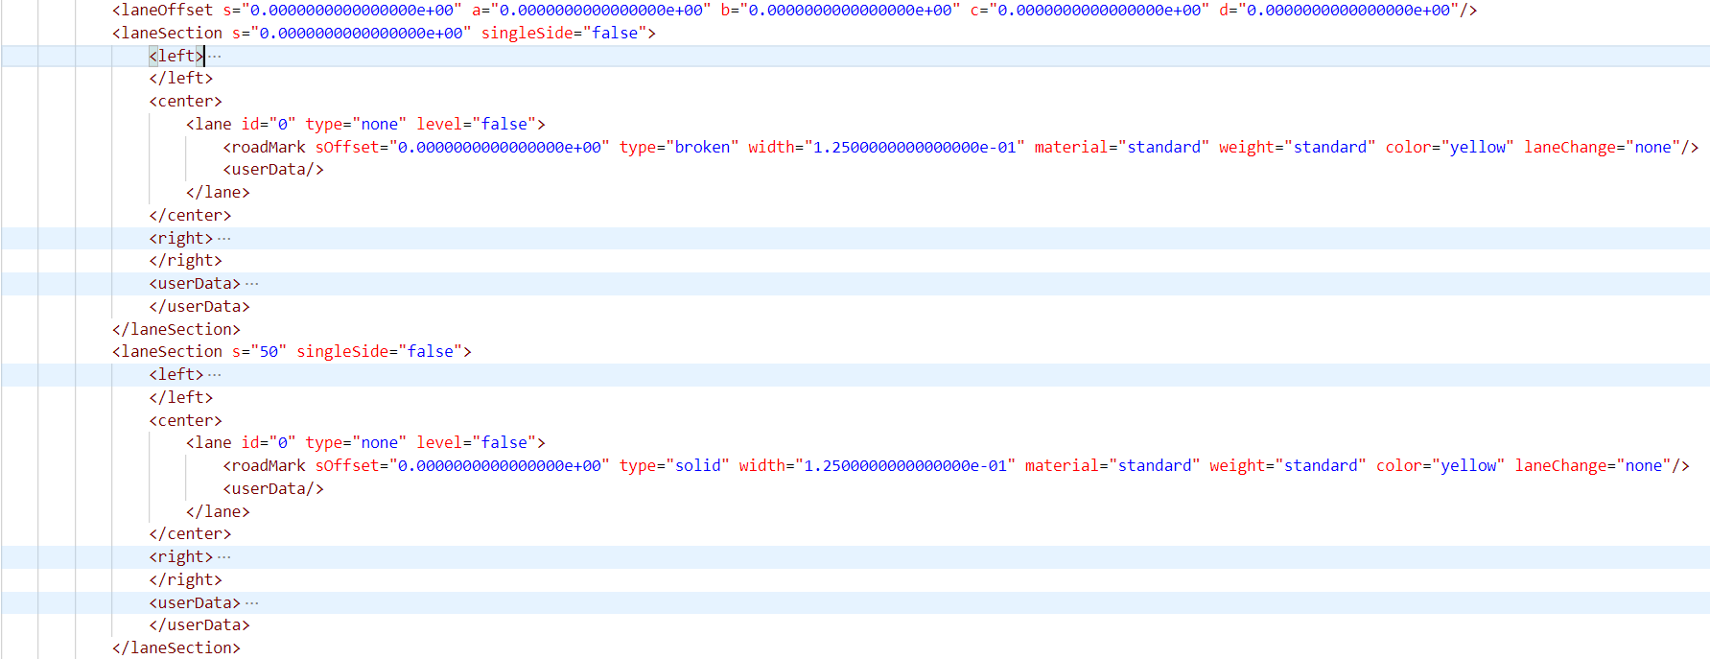
Roadmark can also be changed in the midway. A new <laneSection> needs to be created for this end.
Added lane section for a new roadmark at 50 meters.
Original road. The road mark changes from dashed yellow to solid yellow in the center.
Modified road can be found: https://github.com/ivsg-psu/PathPlanning_MapTools_ParseXODR/blob/main/Data/XODRExport/XODRExport/RR/02ExportedFromScene/TestLaneProperties/RR_RoadMarkChange_20230908.xodr

Slide 26
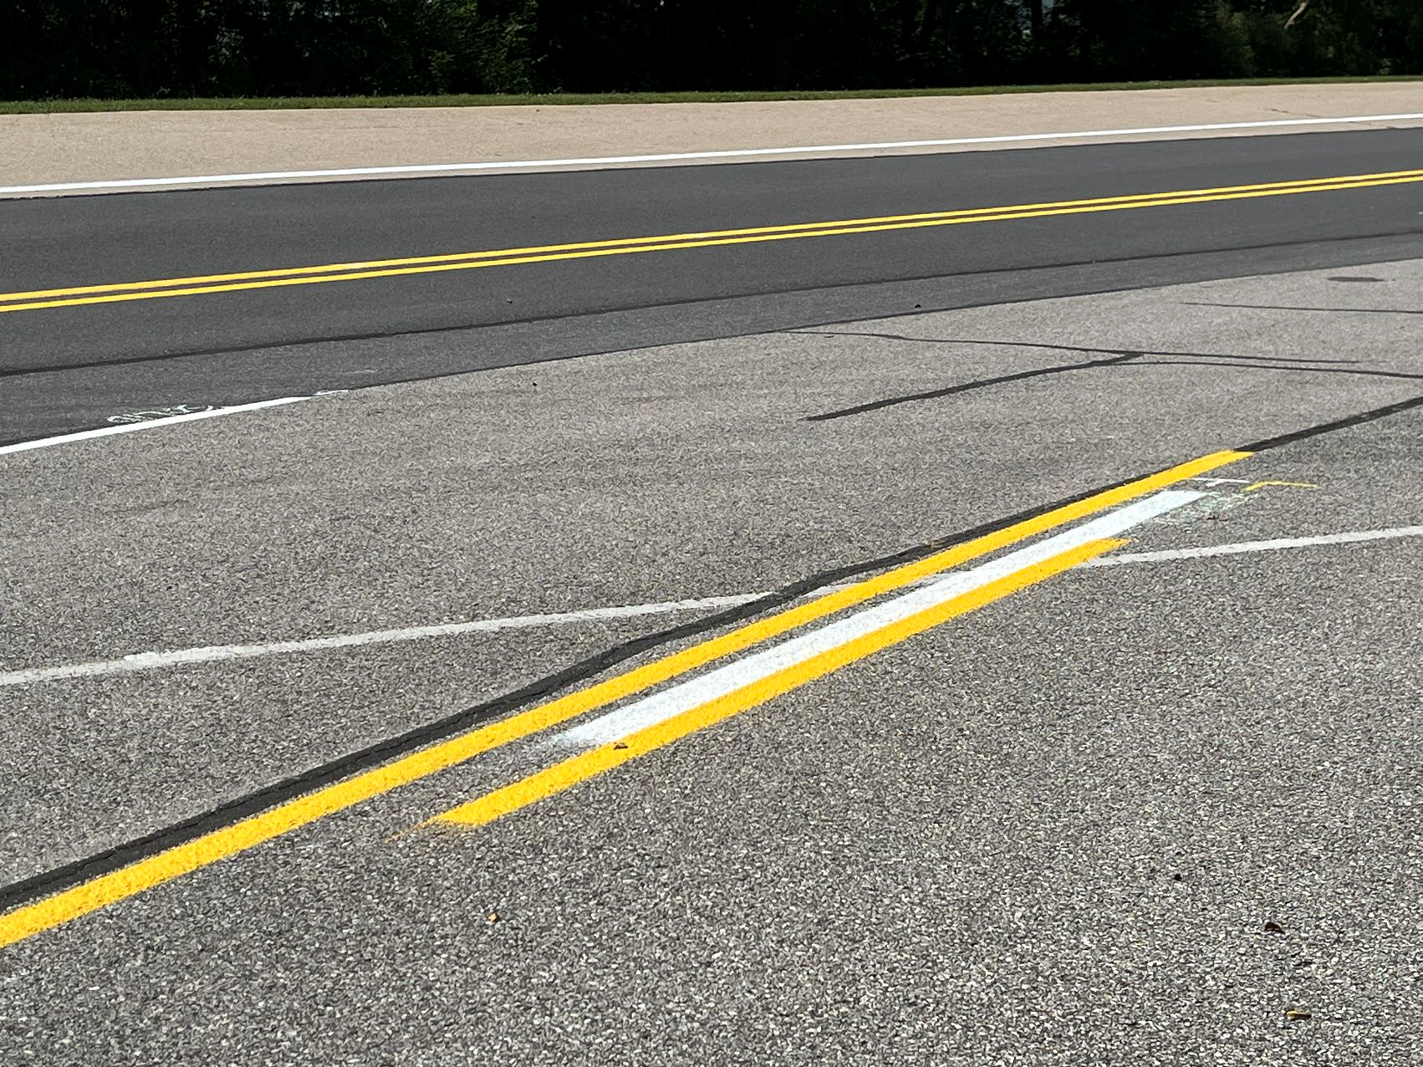
One issue with HD maps: the HD definition of marker start/ends of stripes do NOT capture real-world start/end locations

Slide 27
Step 7. Lane speed is described.

Slide 28
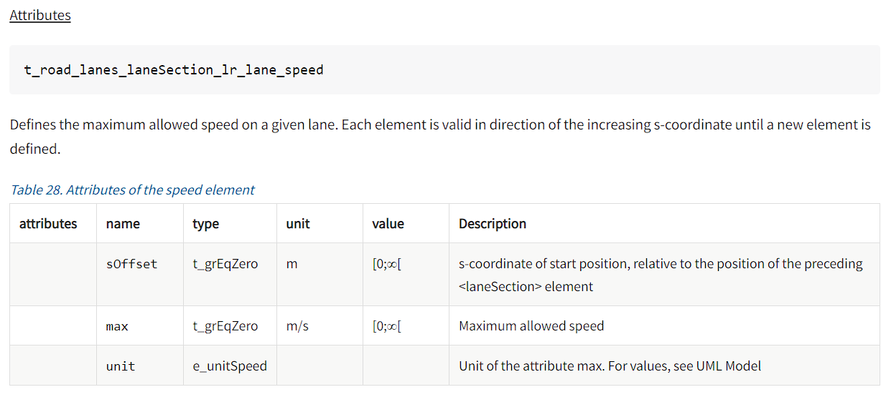
Step 7. Attributes of speed are below.

Slide 29
Change of speed has no effect on visuals. However it affects the traffic rule applying to vehicles.
Original lane
Lane with modified max speed and unit

Slide 30
Step 8. UserData is described as “external” data. The attributes are not clearly defined in ASAM OpenDrive. However, this can usually be generated automatically by RoadRunner so it is not mandatory.

Slide 31
We learned lessons during investigation of lane property definitions:
1. Importance of Clear Definitions:
Clear definitions of lane properties are essential for generating HD maps from mapping data automatically.
2. Conversion of Field Data:
Lanes are usually constructed as polynomials, which isn't how the mapping process is typically done. Therefore, fitting tools are used to convert actual field data points into these polynomial representations.
3. Lane Ambiguities in Construction Zones:
Describing lanes within construction zones is challenging, and lane ambiguity is a significant hurdle for autonomous vehicles.
4. Limitations in Current Tools and Standards:
The effect of certain attributes, like the "singleSide" attribute, is not always visually represented in tools, but may influence traffic rules.
Changing certain attributes, like switching from <left> to <right>, can break the file due to conflicts.
Some attributes' changes aren't visually represented in open-source tools, such as changes in road marks, but can be visualized in proprietary tools like RoadRunner.
5. Importance of Lane Width Representation:
Lane widths in HD maps change within certain areas (like work zones), and this change is often represented as a polynomial. This makes defining a lane's "centerline" crucial.
6. HD Map Definitions vs. Real-World Representations:
HD definitions of markers (like the start and end of stripes) do not always match real-world start/end locations, leading to potential discrepancies.
7. Visual vs. Functional Attribute Changes:
Changes in some attributes, like lane width, are visually represented, while others, like speed limits, aren't visual but affect traffic rules.
8. Ambiguities in External Data:
The UserData attribute in ASAM OpenDrive isn't clearly defined, leading to potential uncertainties.

